Slide 1


Enterprise Risk Management
Mike Wetklow and Rafael Cotto
Advisory Committee for Business and Operations
May 11, 2016

Slide 2
Overview
Introduction
Enterprise Risk Management (ERM) Defined
Upcoming Office of Management and Budget (OMB) Requirements
BFA ERM Pilot
7 Point Implementation Plan
Risk Maturity Model

Slide 3
Introduction

Slide 4
What is ERM?
Risk is the effect of uncertainty on objectives. Risk management is coordinated activity to direct and control challenges or threats to achieving an organization’s goals and objectives. ERM is an effective agency-wide approach to addressing the full spectrum of the organization’s significant risks by understanding the combined impact of risks as an interrelated portfolio, rather than addressing risks only within silos. ERM provides an enterprise -wide, strategically-aligned portfolio view of organizational challenges that, provides better insight about how to most effectively prioritize and manage risks to mission delivery. While agencies cannot mitigate all risks related to achieving strategic objectives and performance goals, they should identify, measure, and assess challenges related to mission delivery, to the extent possible.
Source: OMB Circular No. A-11
8

Slide 5
What is ERM?
Effective Risk Management:
creates and protects value;
is an integral part of all organizational processes;
is part of decision -making;
explicitly addresses uncertainty;
is systematic, structured, and timely;
is based on the best available information;
is tailored and responsive to the evolving risk profle of the agency;
takes human and cultural factors into account;
is transparent and inclusive;
is dynamic, iterative, and responsive to change; and
facilitates continual improvement of the organization.
  Source: OMB Circular No. A-11
8

Slide 6
Upcoming OMB A-123 “Management’s Responsibility for Internal Controls” Requirements
OMB A-123 Deliverable | Description
ERM Implementation Plans by September 15, 2016 | First major milestone that we have to meet as an agency. It involves developing a plan for implementing ERM into NSF’s management practices, including a governance structure and the process that NSF expects to use to facilitate embedding the ERM into our agency’s decision making process.
Initial Risk Profile by January 20, 2017 | To the extent feasible, agencies are encouraged to develop an initial (i.e., first draft) risk profile over the course of FY 2016, for presentation to the incoming Administration on January 20, 2017, recognizing that in some cases these initial profiles may lack some elements and may not be comprehensive, depending on agency capacity.
Complete Risk Profile by May 15, 2017 | A full risk profile should be developed by May 15, 2017 to inform the development of the new Agency strategic plans and the FY 2019 Budget. A-123 also requires agencies to develop a maturity model approach to continuously build risk identification practices over time (i.e., OMB expects an ongoing process to manage new or emerging risks).
Note: Draft and Subject to Change

Slide 7
BFA ERM Pilot
Successes:
  Provided a quick snapshot of every division's priorities and focused work; figuring out common ground was helpful
  Developed an initial set of strategic risks
  Tied risks to objectives based on outcome of informed discussion.
  Gained insight from BFA management on risk management
Continuing Challenges:
  Defining ERM scope and goals
  Developing a common lexicon for ERM and risk management
  Confirming universe of risks (i.e., risk register)
  Confirming strategic risks (i.e., risk profile)
  Embedding ERM into BFA’s strategic decisions
  Providing ERM updates and continuing education
8

Slide 8
7 Point Implementation Plan
Support from the Top is a Necessity: ERM initiatives must be enterprise wide and viewed by leadership as an important strategic effort. If done right, ERM will enhance decision making and enable NSF to better define and proactively respond to risk.
Build ERM Using Incremental Steps: Start small by breaking down ERM into more manageable parts and grow over time. For example: Implement ERM in one organization within the Agency that has cross-functional impact; use it as a model for the rest of the Agency.
Focus initially on a Small Number of Top Risks: First identify a small number of strategic risks that are important to NSF’s leadership (e.g., risks to specific programs or facilities, the Merit Review Process or NSF’s Relocation) and that we can manage and evolve from that starting point.

Slide 9
7 Point Implementation Plan (cont.)
Leverage Existing Resources: Work with existing staff and management working groups with knowledge and capabilities relating to risks and risk management. If done right, ERM can reduce duplicity of compliance efforts.
Build on Existing Risk Management Activities: Inventory NSF’s risk management activities that are already in place, such as Polar Program and Office of Budget, Finance, and Award Management risk management activities. Use these activities to start and align them with the ERM process.
Embed ERM into the Decision Making Practices of the Organization: Make sure ERM becomes a supporting tool for informing NSF’s decisions and processes at all levels of the agency.
Provide Ongoing ERM Updates and Continuing Education for Leadership and Senior Management: ERM is an evolving practice and it’s important for leadership to receive updates on best practices.

Slide 10
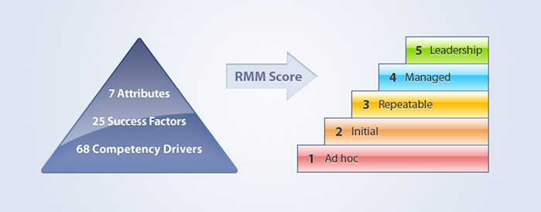
Risk Management Society
Risk Maturity Model
https://www.rims.org/resources/ERM/Pages/RiskMaturityModel.aspx

